Slide 1


US Census – Immigration Related Statistical Analysis
BIG DATA – HADOOP
GITABASHYAN RAMAMOORTHY
S170030600311
NIIT Limited

Slide 2

Big Data
Big data is being generated by everything around us at all times. Every digital process and social media exchange produces it. Systems, sensors and mobile devices transmit it.
3 V’s of Big Data

Slide 3

Apache Hadoop
Open-source software for reliable, scalable, distributed computing.
Hadoop framework allows for distributed processing of large data sets across clusters of computers using simple programming models.
It is designed to scale up from single servers to thousands of machines.
High-Availability and tackle failures
Framwork contains - Hive, Pig, Hbase, Sqoop, Flume, Oozie, Zookeeper, etc.

Slide 4

Census
The census is a special, wide-range activity, which takes place once a decade in the entire country.
Its purpose is to gather information about the general population, in order to present a full and reliable picture of the population in the country - its housing conditions and demographic, social and economic characteristics.The information collected includes data on,
Age
Gender
Country of origin
Marital status
Parents
Tax Status, Education, Income etc.

Slide 5
Project Outline
Input : Sample of US census data [JSON format]
Data Fields : Age, Education, Marital Status, Gender, Tax Filer Status, Income, Parents, Country of Birth, Citizenship, Weeks Worked
Lookup File : Age, Age Group
Analysis : Demographic Analysis – Education, Social and Economy
Calculations : Poverty, Tax per individual, Per Capita and Median Income
Purpose :
Analysis helps government to make policies and planning like, creating job for immigrants, plan improved and extended health care, protect the right to vote for those naturalized, under Civil Rights Act and ensures equal employment opportunity, allocation of funds for schools and elderly people’s health care and social security assistance.
Damping of Vibration in a cantilever beam with an electromagnet
using NI LabVIEW
And MyRIO

Slide 6
Query
1. Age group wise Immigration Percentage
2. Education wise Immigration Percentage
3. Population and Poverty Distribution
4. Which country sources large educated people and contributes more to USA by tax?
5. Tax Distribution and Per Capita Income between Natives and Immigrants, Is “Immigrant Ban” required?
Analysis related files are available in
https://github.com/bashyan/Immigration_Data_Statistical_Analysis

Slide 7
Project Flow
JSON
Conversion using HIVE, Pig
Data in Hive Table, CSV File
Analysis
Project Mode: Hadoop standalone mode
Tools : MapReduce, Hive, Pig, Sqoop

Slide 8
Input Files Details
Census sample file contains,
Age
Education
MaritalStatus
Gender
TaxFilerStatus
Income
Parents
CountryOfBirth
Citizenship
WeeksWorked
The lookup file contains,
Age
AgeGroup

Slide 9

Demographic Analysis
Tool : Hive
Prerequisite : Sample data and lookup files should be loaded in Hive table.
Sample data loaded in ‘census’ table and lookup file loaded in ‘age’ table of database ‘immigration’
Age group wise Immigrant Population
hive (immigration)> select b.agegroup as Age_Group, round((count(a.Citizenship)/t.tot)*100,2) as Immigrants_Percentage
from
census a, age b,
(
select
(count(Citizenship)) as tot
from
census
where (Citizenship=" Foreign born- Not a citizen of U S " or Citizenship= " Foreign born- U S citizen by naturalization")
) t
where a.age=b.age and (a.Citizenship=" Foreign born- Not a citizen of U S " or a.Citizenship= " Foreign born- U S citizen by naturalization")
group by b.agegroup, t.tot;

Slide 10
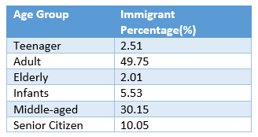

Slide 11
Education Group Wise Immigrant Population
hive (immigration)> select education,round((count(Citizenship)/t.tot)*100,2) as Immigrants_Percentage
from
census,
(
select (count(Citizenship)) as tot
from
census
where (Citizenship=" Foreign born- Not a citizen of U S " or Citizenship= " Foreign born- U S citizen by naturalization")
) t
where (Citizenship=" Foreign born- Not a citizen of U S " or Citizenship= " Foreign born- U S citizen by naturalization")
group by education, t.tot
order by Immigrants_Percentage desc;

Slide 12
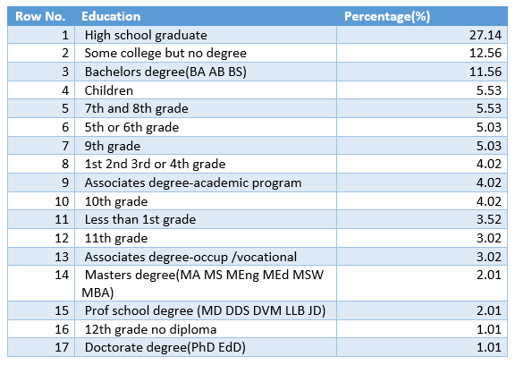
Education wise Immigrant Population

Slide 13

Population and Poverty Distribution:
Tool : Pig
Prerequisite : Sample data and lookup data available for Pig to load
UDF : Apache DataFu Pig is a collection of user-defined functions for data analysis
Methodology : For code reusability, Pig commands are executed in BATCH MODE using .pig script file
Pig Script : Scripts are written for calculating poverty using median income of entire record, percentage of population distribution and poverty distribution.
Output : Output is formatted using Pig’s built-in CONCAT() function.

Slide 14
Output: /PovertPercentage/part-r-00000 file,
Total Sample Population 2000
Total Natives Percentage 90.05% of total population
Total Immigrants Percentage 9.95% of total population
Total Poverty Percentage 20.1% of total population
Native Poverty percentage 19.66% among natives
Native Poverty Percentage 88.06% among total poverty
Immigrant Poverty Percent. 24.12% among immigrants
Immigrant Poverty Percent. 11.94% among total poverty
Infant Poverty Percentage 2.01% among immigrants
Oldage Poverty Percentage 3.02% among immigrants

Slide 15
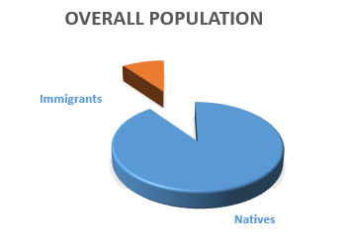
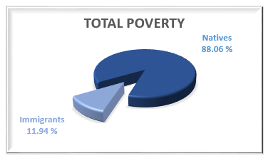
Visualization
Population Distribution
Poverty Distribution

Slide 16
Which country sources large educated people and contributes more to US by tax?
Tool : Pig
Prerequisite : Sample data with tax details[calculated by MapReduce] available for Pig to load, no lookup file needed
Procedure :
1. Tax Contribution : Extracting Immigrants then grouping by country and then calculating total tax of every country and ordering descending to find the top country
2.Education : Extracting Immigrants with education “High School Graduate and above”, grouping by country and counting total record for every country
Output : Analysis report is written using CONCAT() function and stored as part- r-00000 files

Slide 17
Output 1: /CountryTaxPaid/part-r-00000 file,
Tax Contribution : Mexico contributed more in income tax and accounted for about 31.77% of total tax revenue from immigrants
Output 2: /CountryEducated/part-r-00000 file,
Educated Immigrants : Mexico sources more educated immigrants and accounts 18% of total educated immigrant population

Slide 18

Socio - Economic Analysis – Tax Distribution and Per Capita Income between Natives and Immigrants
Tool : MapReduce, Eclipse
Prerequisite : Sample data files should be in HDFS
Methodology:
Reduce Side Join is used in this process. One Mapper calculate TAX and other Mapper is meant for cleansing data for Per Capita Income calculation. The reducer calculate the tax distribution and per capita income (mean income).
For Tax Nonfilers, tax is calculated considering the individual as ‘Single’ filer
MapReduce code is available in GitHub,
https://github.com/bashyan/Immigration_Data_Statistical_Analysis/blob/master/taxpayer.java

Slide 19
Output part-r-00000 file,
1, USA Total Tax: $ 4001038.81
2, Total Immigrant Tax: $ 405905.40
3, Immigrant Nonfiled Tax: $ 87723.19
4, Total Native Tax: $ 3595133.41
5, Native Nonfiled Tax: $ 657909.09
6, US Mean Income: $ 20739.14
7, Immigrant's Mean Income: $ 18269.87
8, Native's Mean Income: $ 21011.98
On further calculation, it shows that on an average, Immigrant pay tax 2.1% more than Native
people and the per capita income of Immigrant is 13.05% lesser than Native. It signifies that
Immigrant’s contribution to US wealth is highly assessable and rising ban on Immigrant will
decline the nation’s revenue.

Slide 20
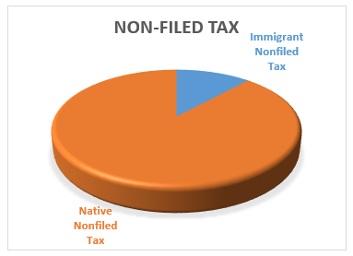
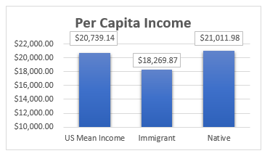
Socio-Economic Data Visualization

Slide 21



Data Export to Relational Database
The census data can be used whenever needed, apart from HDFS, it is better to export data to the local database where analysts do simple query in MySQL and do analysis in future.
This can be achieved using Apache Sqoop,
Sqoop is used to import and export data from or to Relational Databases

Slide 22

HDFS to MySQL
Using Sqoop export command the data can be exported
~$ sqoop export --connect jdbc:mysql://localhost/census --username root --password ‘--' --table census_data --export-dir /immigrantProject/Censusdata/tax/part-m-00000;
In MySQL, the table can be used for further analysis
mysql> select Education, round(sum(tax),2) as Tax_Paid from census_data group by education order by tax_paid desc limit 3;
Output :

Slide 23
Analysis Report: from the sample census data
In overall population 9.95% people are foreign born.
Adult age group with high school graduated are the large numbers of foreign born living in USA.
Poverty strikes 20.1% of total population and 24.12% of immigrants are living under poverty.
Among immigrants, children and elderly people have poor standard and are under poverty, they comprise nearly 2.01% and 3.02% respectively.
Mexico sources more immigrants and their population contribute 31.77% tax revenue.
The per capita income of immigrants is lesser than that of natives, as it shows that immigrants are paid lesser.
Analysing the tax filer details, more number of immigrants and natives doesn’t file their income tax.

Slide 24
Suggestions from the report:
Native people standard should be improved and more jobs to be created for natives.
Children and old age immigrants have lesser poverty level, healthcare and education for them can be improved. They should be given higher social security assistance.
The per capita income of immigrants is 14% lesser than that of natives, Civil Rights Act to be revised and equal employment opportunity and salary should be ensured.
As tax revenue lost by non-filer shows significant amount, more number of campaigns can be arranged to create awareness among people.
More immigrants come from Mexico, and the diplomatic relationship to be improved and community/minority education opportunity can be provided for Mexicans.
On analysing the sample census data without considering illegal migrants, the foreign born contribute more to USA and it can be concluded that ‘Immigration Ban’ is not necessary for United States of America.

Slide 25
Thank You

